Slide 1
Designing Experimentation Metrics
Pavel Dmitriev, Microsoft Analysis & Experimentation

Slide 2

Importance of right metrics
In 1902, the French quarter in Hanoi was overrun with rats. A "deratisation" scheme paid citizens for each rat they captured (the proof requested for payment was rat’s tail).
Rats Killed per day
1,000/day
4,000/day
April, 1902
April, 1902
20,000/day
Week 1
Week 2
July, 1902
But they barely made a dent in the problem!
Investigation revealed two phenomena:
Tailless rats started appearing
A thriving rat farming industry emerged in the city
https://community.redhat.com/blog/2014/07/when-metrics-go-wrong/
http://www.freakonomics.com/media/vannrathunt.pdf
https://en.wikipedia.org/wiki/Cobra_effect
Notes:
What you measure is what you get
What you do not measure does not improve
Illustrates the problem with the OEC metric:
Short term metric
Inadequate ‘tail’-metry
Game-able
Sets the wrong incentives - GoodHart Law https://en.wikipedia.org/wiki/Goodhart%27s_law
No guardrails to counterbalance abuse of the metric
What would be a good success metric?
https://hbr.org/2010/06/column-you-are-what-you-measure
https://community.redhat.com/blog/2014/07/when-metrics-go-wrong/
http://www.freakonomics.com/media/vannrathunt.pdf
https://en.wikipedia.org/wiki/Cobra_effect
2:15

Slide 3
Experimentation Metrics Taxonomy
While analyzing the results of an experiment we compute many of metrics of different type and role.
Data Quality metrics
OEC (Overall Evaluation Criteria) metric
Guardrail metrics
Local feature and diagnostic metrics
A Dirty Dozen: Twelve Common Metric Interpretation Pitfalls in
Online Controlled Experiments
Principles for the design of online metrics
Data-Driven Metric Development for Online Controlled Experiments
Seven Rules of Thumb for Web Site Experimenters
Data Quality metrics • OEC metrics • Guard rail metrics • Local feature/Diagnostic metrics
Notes:
0:30

Slide 4
Data Quality metrics
Are the results trustworthy?
Sample Ratio Mismatch (SRM)
Data loss
Click reliability
Cookie churn
Data Quality metrics • OEC metrics • Guard rail metrics • Local feature/Diagnostic metrics
Notes:
@References
1:00

Slide 5
OEC: Overall Evaluation Criteria
Was the treatment successful?
A single metric or a few key metrics
Two key properties:
Alignment with long-term company goals (Directionality)
Ability to impact (Sensitivity)
OEC vs KPIs (Key Performance Indicators)
KPIs are lagging metrics reported monthly/quarterly/yearly at the overall product level (DAU, MAU, Revenue, etc.)
OEC is a leading metric measured during the experiment (e.g. 2 weeks) at user level, which is indicative of long term increase in KPIs
Designing a good OEC is hard
Example: OEC for a search engine
http://www.exp-platform.com/Pages/hippo_long.aspx
http://bit.ly/expUnexpected
http://www.exp-platform.com/Pages/PuzzlingOutcomesExplained.aspx
http://www.exp-platform.com/Documents/2016CIKM_MeasuringMetrics.pdf
Data Quality metrics • OEC metrics • Guard rail metrics • Local feature/Diagnostic metrics
Notes:
3:30

Slide 6
OEC for Search
The two key search engine (Bing, Google) KPIs are Query Share (distinct queries) and Revenue
Should OEC be Queries/User and Revenue/User?
Example:
A ranking bug in an experiment resulted in very poor search results
Degraded (algorithmic) search results cause users to search more to complete their task, and ads appear more relevant
Distinct queries went up over 10%, and revenue went up over 30%
What metrics should be in the OEC for a search engine?
http://www.exp-platform.com/Pages/PuzzlingOutcomesExplained.aspx
Data Quality metrics • OEC metrics • Guard rail metrics • Local feature/Diagnostic metrics
Notes:
2:00

Slide 7
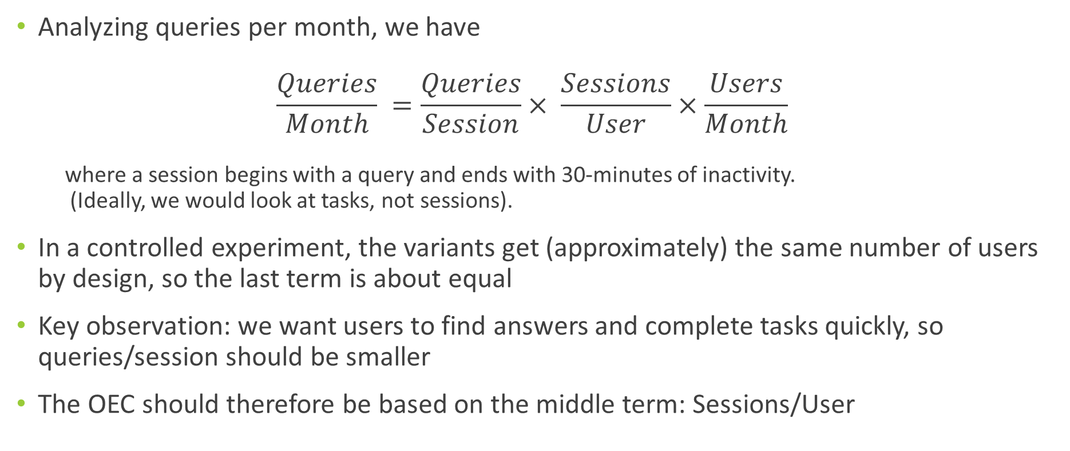
OEC for Search
Analyzing queries per month, we have $\frac{Queries}{Month} =\frac{Queries}{Session}× \frac{Sessions}{User}×\frac{Users}{Month}$
where a session begins with a query and ends with 30-minutes of inactivity. (Ideally, we would look at tasks, not sessions).
In a controlled experiment, the variants get (approximately) the same number of users by design, so the last term is about equal
Key observation: we want users to find answers and complete tasks quickly, so queries/session should be smaller
The OEC should therefore be based on the middle term: Sessions/User
Data Quality metrics • OEC metrics • Guard rail metrics • Local feature/Diagnostic metrics
Notes:
1:30

Slide 8
OEC for Search: Sensitivity
While Sessions/User has great directionality, it rarely moves in our experiments
Both because it is hard to change the pattern of user visits in a short term experiment, and because of its statistical properties
More on this later in the tutorial
The Search OEC we developed includes Sessions/User, but also adds other more sensitive surrogate metrics that are predictive of Sessions/User movement.
Surrogates are based on the concept of search success - how successful were users in their search tasks?
http://www.exp-platform.com/Pages/PuzzlingOutcomesExplained.aspx
Data Quality metrics • OEC metrics • Guard rail metrics • Local feature/Diagnostic metrics
Notes:
1:45

Slide 9
More OEC Examples
Netflix:
Subscription business
KPI: Retention (i.e. the fraction of users who return month over month)
OEC: Viewing Hours. Strong correlation between viewing hours and retention
Coursera:
Care about course completion, make money by users pay for certifications
KPIs: Course completions, # Certificates sold, Revenue
OEC: Test completion and Course engagement. Predictive of course completion and certificates sold
Examples are from “Designing with Data: Improving the User Experience with A/B Testing”
Notes:
Netflix: Because it is a subscription-based business, one of Netflix’s key metrics is retention, defined as the percentage of their customers who return month over month. Conceptually, you can imagine that someone who watches a lot of Netflix should derive a lot of value from the service and therefore be more likely to renew their subscription. In fact, the Netflix team found a very strong correlation between viewing hours and retention. So, for instance, if a user watched only one hour of Netflix per month, then they were not as likely to renew their monthly subscription as if they watched 15 hours of Netflix per month. As a result, the Netflix team used viewing hours (or content consumption) as their strongest proxy metric for retention, and many tests at Netflix had the goal of increasing the number of hours users streamed. (Kindle Locations 2206-2210)
Coursera: Coursera is a credential-driven business; in other words, they make money when users pay for credentials (certifications) after completing a course. One of their key metrics might be the number of credentials sold, or the revenue generated from credential purchases. You might be skeptical about this metric, though, and for good reason: because Coursera courses are often 13-week college classes, measuring how a design changes this metric would take far too long to be practical...Course completion is predicted by module completion, which is in turn predicted by test completion and how often a user engages with a course. So Coursera measures test completion or course engagement as proxies for their key metric, allowing them to cut down the time to measure the impact of a design change dramatically. (Kindle Locations 1266-1269)

Slide 10
How to come up with the right OEC?
In the beginning:
Start simple: frequency of user visits can be a good indicator of user happiness
Evaluate and improve based on “learning experiments”:
An obviously positive change: that will clearly increase user happiness like removing ads
An obviously negative change: like adding latency or decreasing relevance of search results
Continue to improve directionality and sensitivity over time:
Setup a metric evaluation framework: curate a diverse set of labeled experiments agreed to be positive, negative or neutral with respect to long-term value. Test changes to the OEC on this set.
http://www.exp-platform.com/Documents/2016CIKM_MeasuringMetrics.pdf
Data Quality metrics • OEC metrics • Guard rail metrics • Local feature/Diagnostic metrics
Notes:
2:00

Slide 11
Experimentation Metrics Taxonomy
While analyzing the results of an experiment we usually compute 1000’s of metrics of different type and role.
Data Quality metrics
Are the results trustworthy?
e.g. Sample Ratio Mismatch
OEC (Overall Evaluation Criteria) Metric
Was the treatment successful?
e.g. Sessions/User
Guardrail metrics
Did the treatment cause an unacceptable harm to key metrics?
e.g. KPI metrics, Performance metrics, short-term Revenue
Local feature and diagnostic metrics
Why the OEC and guardrail metrics moved or did not move?
e.g. number of impressions and clicks on a feature/button/link
Data Quality metrics • OEC metrics • Guard rail metrics • Local feature/Diagnostic metrics
Notes:
@References
2:45

Slide 12
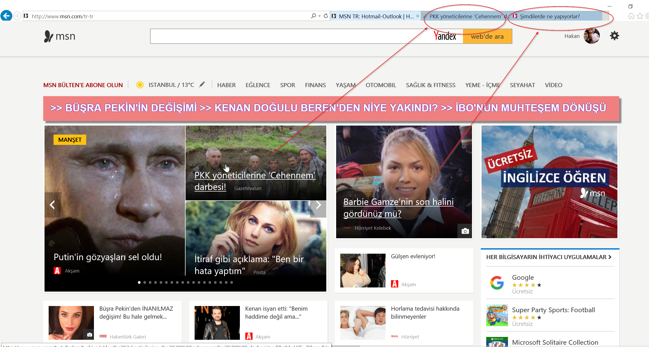

Pitfalls in Metric Interpretation
The situations when the experiment was configured and run correctly, but we can still misinterpret the metrics and end up with a wrong conclusion
“A Dirty Dozen: Twelve Common Metric Interpretation Pitfalls in Online Controlled Experiments” will be presented at KDD 2017 next week.
Puzzling example: treatment made a 1-line Javascript change to open links on MSN homepage in a new tab. The experiment showed ~8% increase in MSN homepage load time.
Treatment
Control

Slide 13
Pitfalls in Metric Interpretation
The situations when the experiment was configured and run correctly, but we can still misinterpret the metrics and end up with a wrong conclusion
“A Dirty Dozen: Twelve Common Metric Interpretation Pitfalls in Online Controlled Experiments” will be presented at KDD 2017 next week.
Puzzling example: treatment made a 1-line Javascript change to open links on MSN homepage in a new tab. The experiment showed a large increase in MSN homepage load time.
Metric-level SRM. The treatment has fewer repeated homepage loads which are usually faster than the first homepage load due to caching. The comparison between the treatment and control population for time to load is not fair & no causal inference can be drawn.
Lessons: alert on metric-level SRMs
Notes:
2:45

Slide 14
Pitfalls in Metric Interpretation
The situations when the experiment was configured and run correctly, but we can still misinterpret the metrics and end up with a wrong conclusion
Attend our talk on Thursday 10am, session AT7, room 200C: “A Dirty Dozen: Twelve Common Metric Interpretation Pitfalls in Online Controlled Experiments”
Puzzling example: treatment made a 1-line Javascript change to open links on MSN homepage in a new tab. The experiment showed a large increase in MSN homepage load time.
Treatment
Control

Slide 15
Pitfalls in Metric Interpretation
The situations when the experiment was configured and run correctly, but we can still misinterpret the metrics and end up with a wrong conclusion
Attend our talk on Thursday 10am, session AT7, room 200C: “A Dirty Dozen: Twelve Common Metric Interpretation Pitfalls in Online Controlled Experiments”
Puzzling example: treatment made a 1-line Javascript change to open links on MSN homepage in a new tab. The experiment showed a large increase in MSN homepage load time.
The treatment has fewer repeated homepage loads which are usually faster than the first homepage load due to caching. The comparison between the treatment and control population for time to load is not fair & no causal inference can be drawn.
Solutions: alert on metric-level SRMs, decompose the metrics
To learn more attend the talk or read the paper!

Slide 16
Summary
Having good metrics is critical
“You get what you measure”
Metrics have different types and roles in the analysis of an experiment
Data Quality metrics, OEC metric, Guardrail metrics, Local feature/Diagnostic metrics
Designing a good OEC is hard
A leading metric measured in a ~2 week period but indicative of long term goals
Start simple and continuously improve over time
Prevent metric interpretation pitfalls
Notes:
1:15

Slide 17
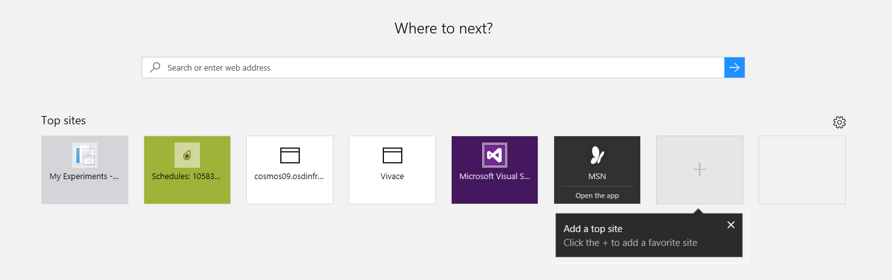
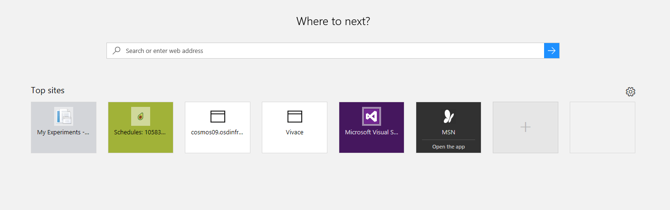
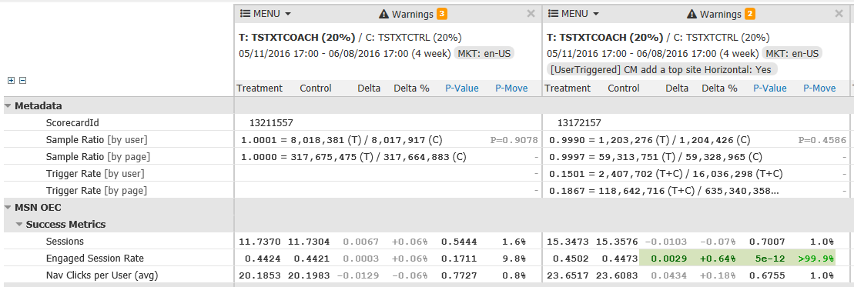
Improving Sensitivity
Example: coach mark to add top sites on Edge browser NTP
Triggered Analysis
Treatment
Treatment: Shows a coach mark to users of Edge browser new tab page (NTP) who meet a certain criteria
Control: No coach mark
Trigger condition: Users who meet the criteria in treatment and control
Control
Untriggered
Triggered
Set of treatment users: 8.0 M
Set of Control users: 8.0M
compare
Users triggered in treatment: 1.2 M
Users triggered in control: 1.2 M
Data Quality metrics • OEC metrics • Guard rail metrics • Local feature/Diagnostic metrics
Notes:
Example with TMPL value
Very large difference in users in triggered and untriggered scorecard
Engaged session rate was flat in untriggered. In triggered scorecard there is a strong signal that it is positive.
Estimated coverage by PM was 30% but in actual the trigger rate is around 15%. Good to have thought of triggering before hand even in cases where you think the coverage is high.
T

Slide 18


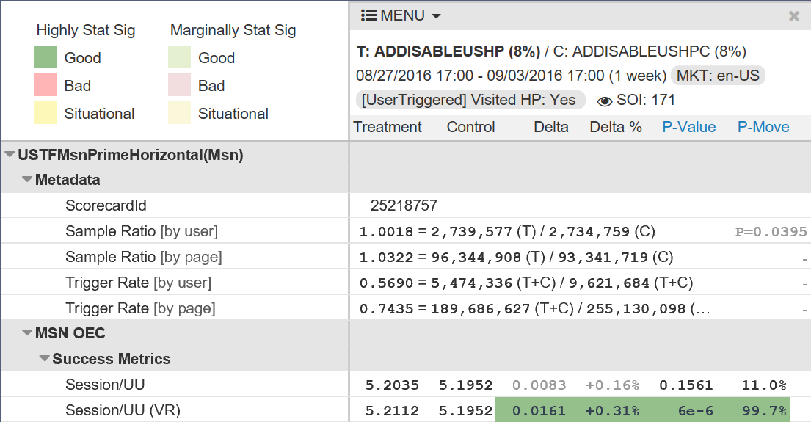
Improving Sensitivity
Example: Hiding ads on MSN homepage
Variance Reduction (VR) through use of pre-experiment data
Treatment
Treatment: Hides display ads on the MSN Prime homepage
Control: Shows ads on the MSN Prime homepage
Cost of hiding ads on the homepage is huge. We need to get results with as little cost as possible.
Control
http://exp-platform.com/cuped/
Data Quality metrics • OEC metrics • Guard rail metrics • Local feature/Diagnostic metrics

Slide 19
Other considerations
Count metrics like page views/UU align well with business goals but are susceptible to spikes and outliers. Always have a metric to measure proportion of users who contribute to the count metric
Ratio metrics are usually more sensitive but harder to interpret when the denominator moves. Always have a decomposition into numerator and denominator metrics. Use delta method to compute the variance of ratio metrics
Percentile metrics are preferred for assessing performance like page load time. Use bootstrap to compute variance of percentile metrics
Conditional metrics are usually more sensitive but are susceptible to metric level SRMs. When possible, have a non-conditional version of the same metric
Truncating outliers reduces variance. Filter outliers if the data points are likely due to a bot or bug. Always have a metric that counts how many data points were truncated/filtered
12 common interpretation pitfalls – KDD paper
Notes:
Single avg v/s double avg

Slide 20
Questions?
http://exp-platform.com

Slide 21
OEC and Product KPIs
KPIs (Key Performance Indicators) are usually lagging metrics measured monthly, quarterly or yearly OEC is a leading metric measured in a 2 week period but indicative of long term increase in KPIs A good KPI can be a bad OEC
KPIs are usually reported at overall product level - total revenue, DAU, MAU Experimentation metrics (and OEC) are usually reported at user level – sessions/user, revenue/ user, days active/ user, ..
KPIs are usually concerned with magnitude only Experimentation metrics (and OEC) are concerned with magnitude and standard deviation
Data Quality metrics • OEC metrics • Guard rail metrics • Local feature/Diagnostic metrics

Slide 22

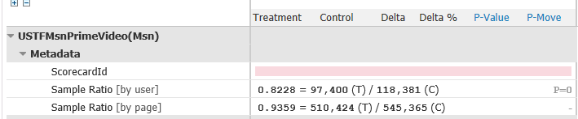

SRM example: video experiment
Treatment: Shows the video in a immersive experience & some code refactoring
Control: Shows the video along with other content
Treatment
(Sample Ratio Mismatch) SRM in scorecard. While almost equal number of users were assigned to treatment and control. In the scorecard, treatment had only 82% users compared to control.
Control
Experiment was stopped early.
Investigation revealed a feature bug.
Only 82% of users got at least one 200 (OK) response compared to control
69K users got a 500 (Internal Server Error) response in treatment compared to 9 in Control.
http://exp/Details?id=76165da3-3847-446d-a078-46b5e21e15f5
https://avocado/report_executions/8750980
Data Quality metrics • OEC metrics • Guard rail metrics • Local feature/Diagnostic metrics
Notes:
2 mins
Total 38 mins
Another case: http://exp/Details?id=38ee6a39-2abb-41d3-8fde-5c5b67947b2c JS perf improvement. Pageviews went down by 50%

Slide 23
Challenges in designing a good OEC
Directionality
Directionality: Goal metric/OEC need to have a clear direction of improvement (at least most of the time)
Sensitivity
P(Detect the change| Treatment caused a change) is the (average) statistical power of a metric. It is influenced by sample size, variance and magnitude of actual change – bigger the change higher the power.
Very few treatments will actually impact user behavior metrics like sessions per user by a large amount. We need high statistical power to detect small changes in this metric.
Data Quality metrics • OEC metrics • Guard rail metrics • Local feature/Diagnostic metrics
Notes:
Sessions/user:
P(H1) is very low. User behavior metrics are hard to improve
If a change causes session to increase, the increase is usually very small
We need high statistical power to improve sensitivity

Slide 24


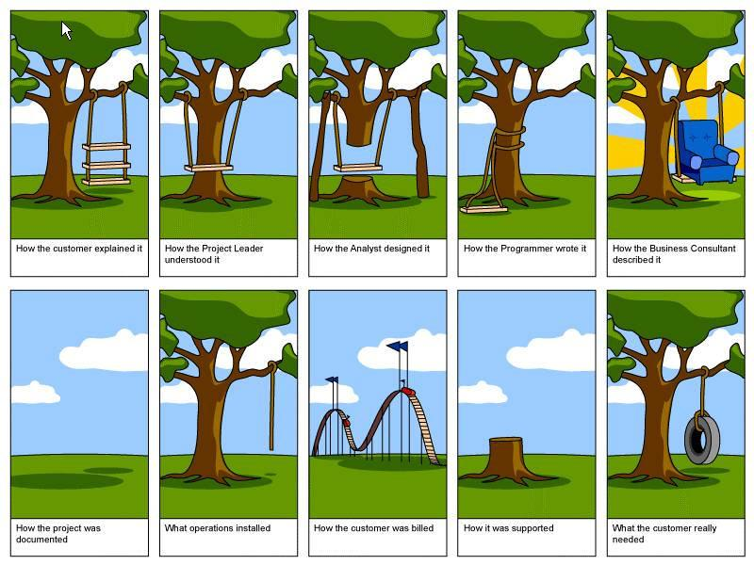

Deciding What to Ship
Observe
Debate
Build
Wonder
Data Toolbox for Decision Making
Qualitative
UX lab studies
Site visits
Focus groups
Quantitative
Surveys
Instrumentation and usage
Missing: Trustworthy Controlled Experiments
Notes:
Process that follows these stages
Antic-dote about SQL Server UI
Tools that help guide decisions: surveys, studies, trained experts
Missing tool is online experimentation

Slide 25
Experiment Driven Decision Process
Improve Metric X?
Debate
Brainstorm
Build
Compare
Notes:
Online experimentation really changes the conversation about how software gets built
Debate moves up, is about metrics
Team is freed up to brainstorm ideas and plan experiments
Antic-dote
Building can take more time. Careful attention here to reducing build costs and enabling cheap ideas
Comparison adds time, but also deeper understanding of what moves the product

Slide 26
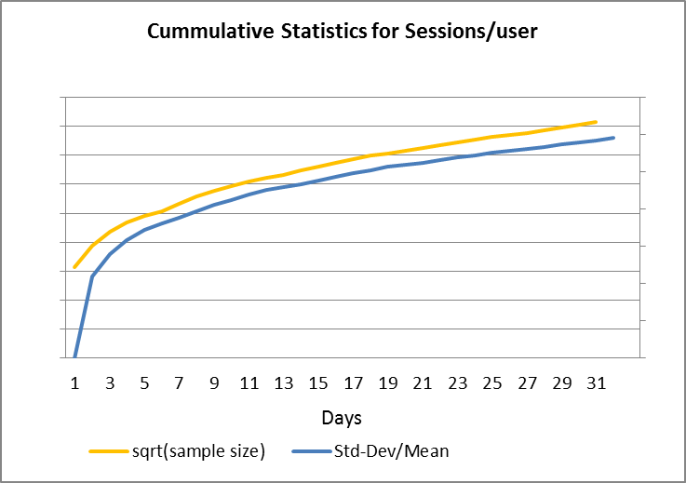
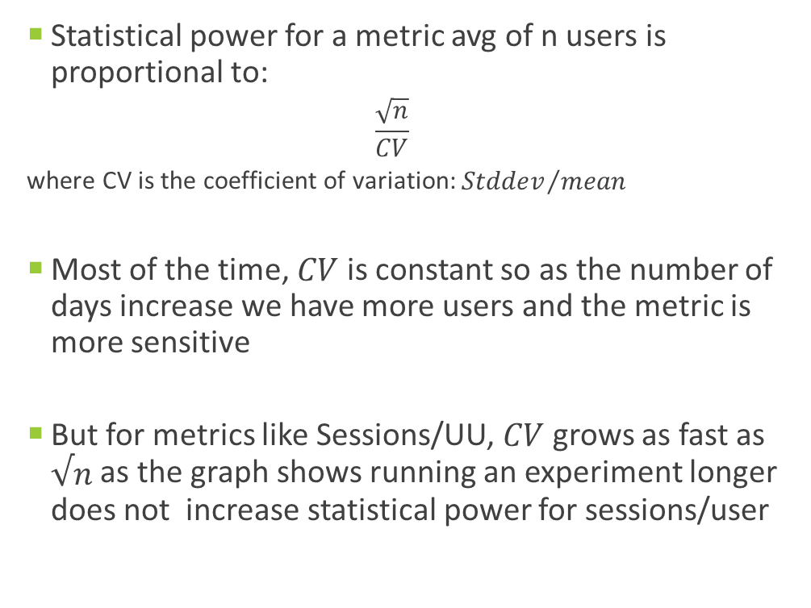
OEC for Search: Sensitivity
Sensitivity of a metric is the probability that this metric will have a stat sig change in an experiment
Sensitivity depends on
The magnitude of the change (determined by the types of experiments being run)
The duration of the experiment
Statistical properties of the metric
Can we just run the experiment for a longer duration?
Statistical power for a metric avg of n users is proportional to:
$$\frac{\sqrt{n}}{CV}$$
where CV is the coefficient of variation: ${Stddev}/{mean}$
Most of the time, $CV$ is constant so as the number of days increase we have more users and the metric is more sensitive
But for metrics like Sessions/UU, $CV$ grows as fast as $√n$ as the graph shows running an experiment longer does not increase statistical power for sessions/user
http://www.exp-platform.com/Pages/PuzzlingOutcomesExplained.aspx
Data Quality metrics • OEC metrics • Guard rail metrics • Local feature/Diagnostic metrics
Notes:
Coefficient of variation
Sessions: P(H1) is low
Power is good.

